Slide 1


Stack Overflow
(BigQuery Dataset)
Loem ipsum dolor sameman tanam casectetur adipiscing elit tamam dalam qoue sampe. dolor sameman tanam casectetur adipiscing elit tamam dalam qoue sampe.
G1-Group 3
LI LING
LI ZUXIAN,
LYU XUDONG,
SHEN JIAJUN,
WANG KUAN,
ZHONG ZHEWEI

Slide 2
目录 | CONTENTS
关键词
关键词
关键词
关键词
01
02
03
04
Introdction
标题文本预设
标题文本预设
Conclusion
此部分内容作为文字排版占位显示 （建议使用主题字体）
此部分内容作为文字排版占位显示 （建议使用主题字体）
此部分内容作为文字排版占位显示 （建议使用主题字体）
此部分内容作为文字排版占位显示 （建议使用主题字体）

Slide 3
Content
Background & Motivation
Dataset
Community detection
Social frequent pattern
Text analytics
Conclusion and future work

Slide 4
Background
Question and answer site
Professional and enthusiast programmers
Topics in computer programming
Motivation
Course consultant who can……
Understand the popularity of programming languages for this year
Understand which subcategories of each programming language are mostly discussed
Understand which applications these popular programming languages are used for

Slide 5




Data Source
Time Period
Data Description
Data Size
Tool
2009, 2012, 2015
2018, Jan–May 2020
Stack Overflow: Questions and Answers
2018: 2,315,304 rows
2020: 888,706 rows
Bigquery:
Use SQL to query data from Google Cloud

Slide 6
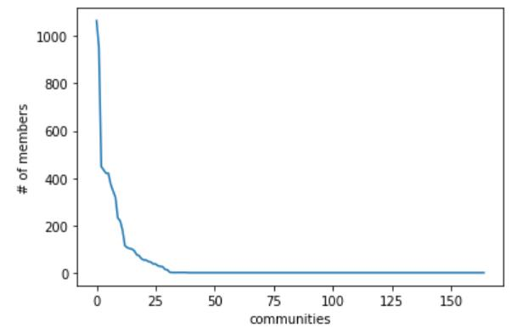
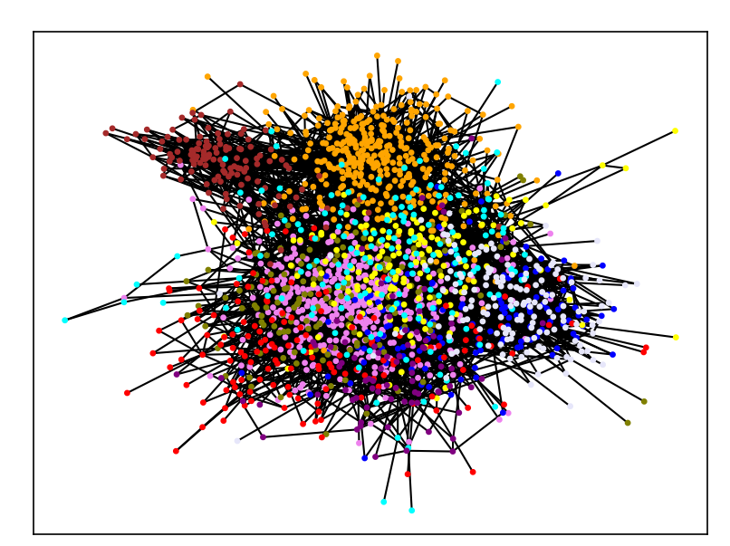
Community Detection
We run community detection to detect the community of users in stack overflow.
Join questions posts with answer posts in each year
Filter all active users
Definition: Active users must post more than 10 questions or answers in a year.
Filter all questions and answers of active users
10
Calculate the frequency of Q&A between two certain users as the weight of the graph
Run community detection
Package: community_louvain.best_partition
JS & React
Count tags of questions to find the theme
Python
Java

Slide 7
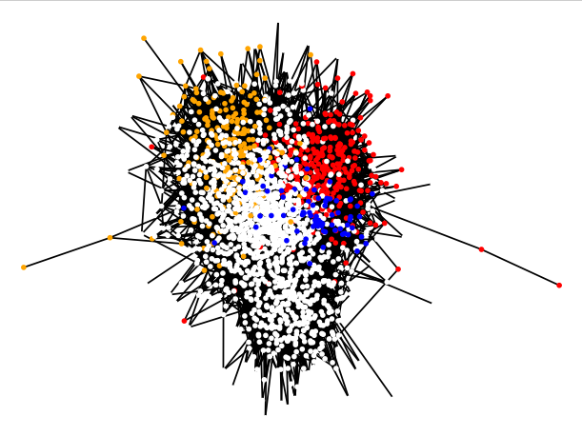
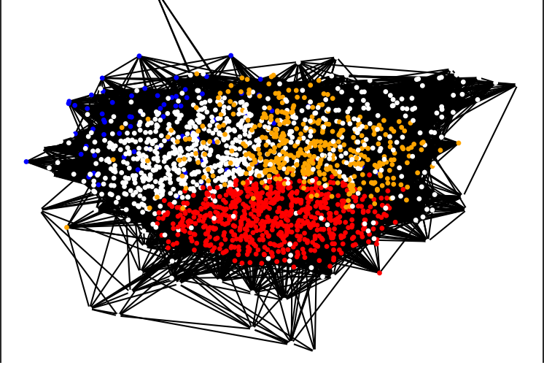
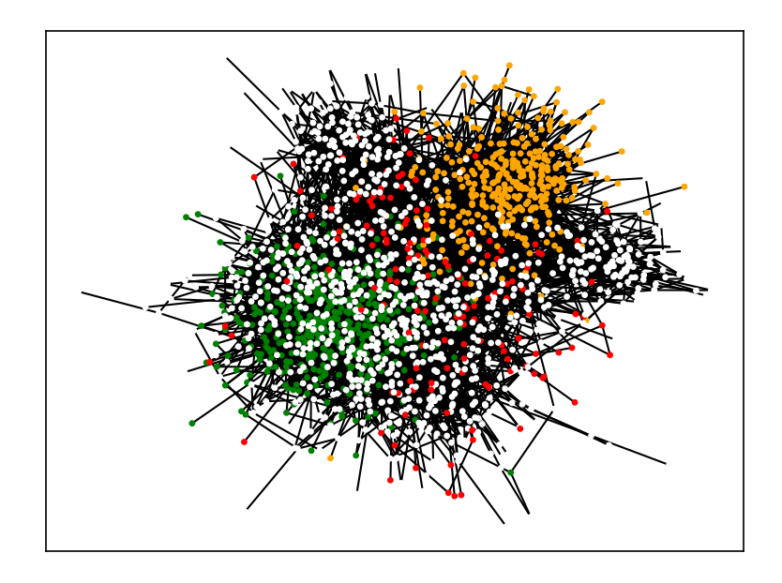

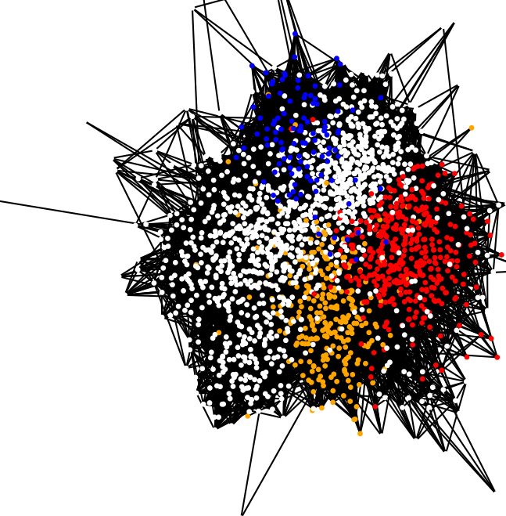
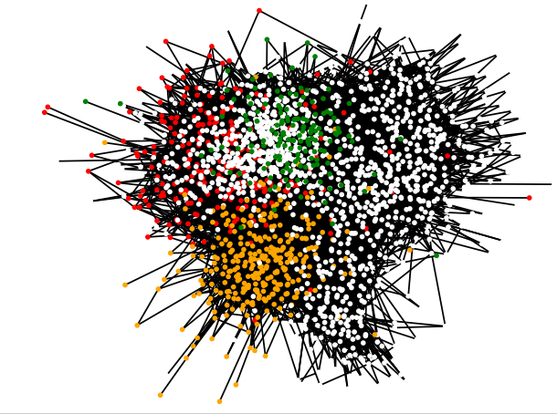
Community Change by Time
We run community detection to detect the community of users in stack overflow.
2009
2012
2015
2018
2020
C#
Ruby
Python
React

Slide 8
Community Change by Time
We run community detection to detect the community of users in stack overflow.
C#: Gets less popular, at least for freshman
Ruby: Disappear from top 10 communities
Python: Becomes popular with ML
React: Emerging JS library for frontend
* In 2020, in ‘React’ community, there are some questions about JS.

Slide 9
Frequent Pattern Mining
Find top communities
Find the most frequent appeared and important tags in the dataset. As shown above, python is the most popular language.

Slide 10
Frequent Pattern Mining
Deep Dive in Python
Frequent pattern mining using Apriori Algorithm is used on python. The chart reveals frequent patterns with support larger than 2%.

Slide 11
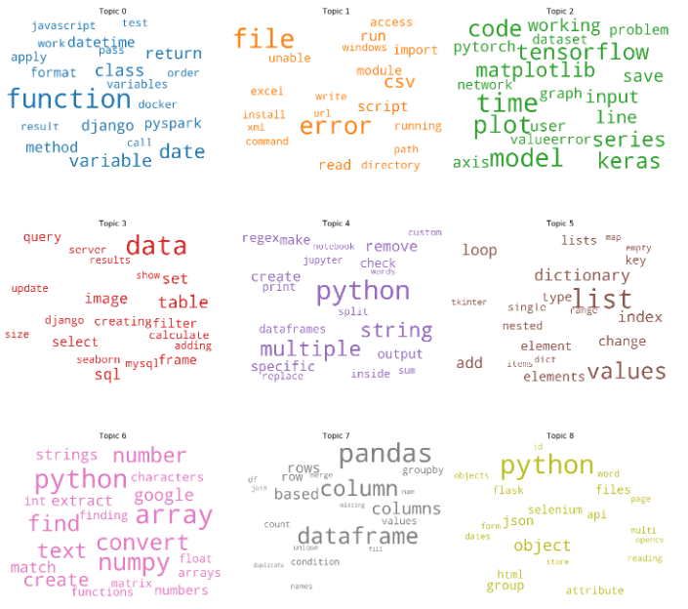
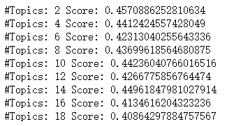
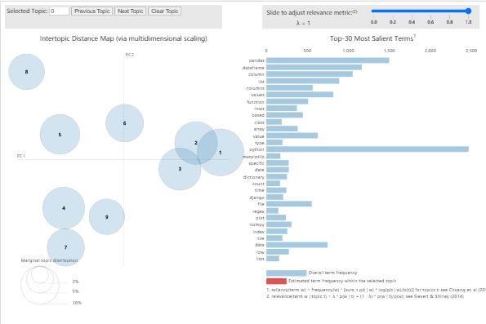
05
Text Analysis
Coherence value
WordCloud
Visualizing Topics
标题文本预设
Notes:
I’ll introduce the text analysis part for our project of Stack overflow data through Posts_questions dataset. In order to approve our objectives, we will build topic model to find out topics each of which is a set of words frequently co-occurring together.
There are big mass questions from users but Stack overflow our other user doesn’t able quick know any really meaningful or specific topics. Maybe sometimes, a lot of users asked same question but nobody know there alr has the same question, so that would be reduce the efficiency of the website.
We will cover three parts of text analysis.
First, I will talk about how to pick the LDA models and how we find the most meaningful topic.
And then, After we get the most meaningful model, we try to observe and analysis what are the topic keywords in each topic under this meaningful model, at the same time, we have some insights for each topics.
Finally, We did the modeling visualization of these topics, and get the dominant topic.

Slide 12
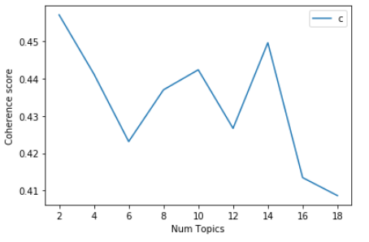
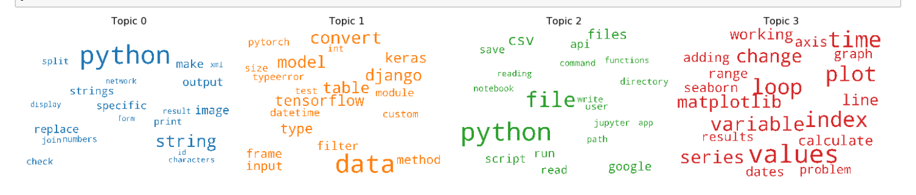
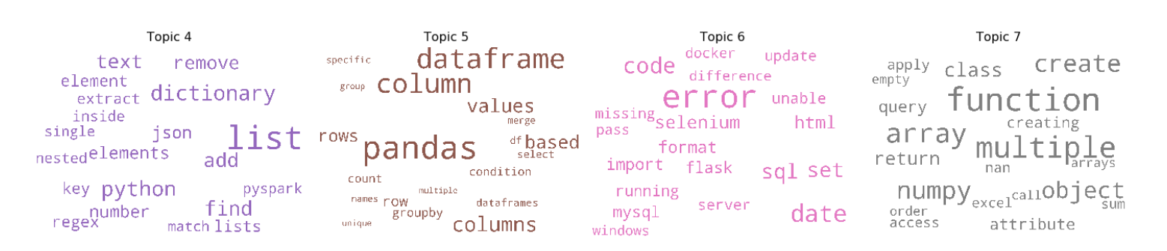
Topic Modeling Analysis for Python

Slide 13
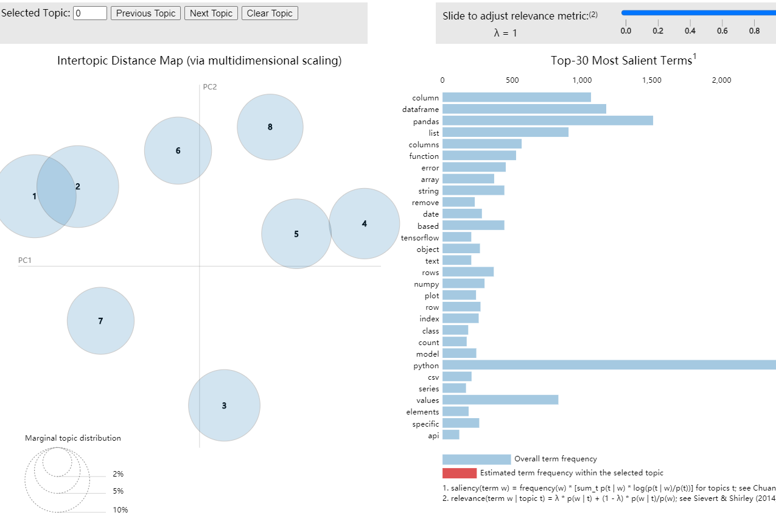
Visualizing Topics
10 topics model
8 topics model

Slide 14
WordCloud

Slide 15
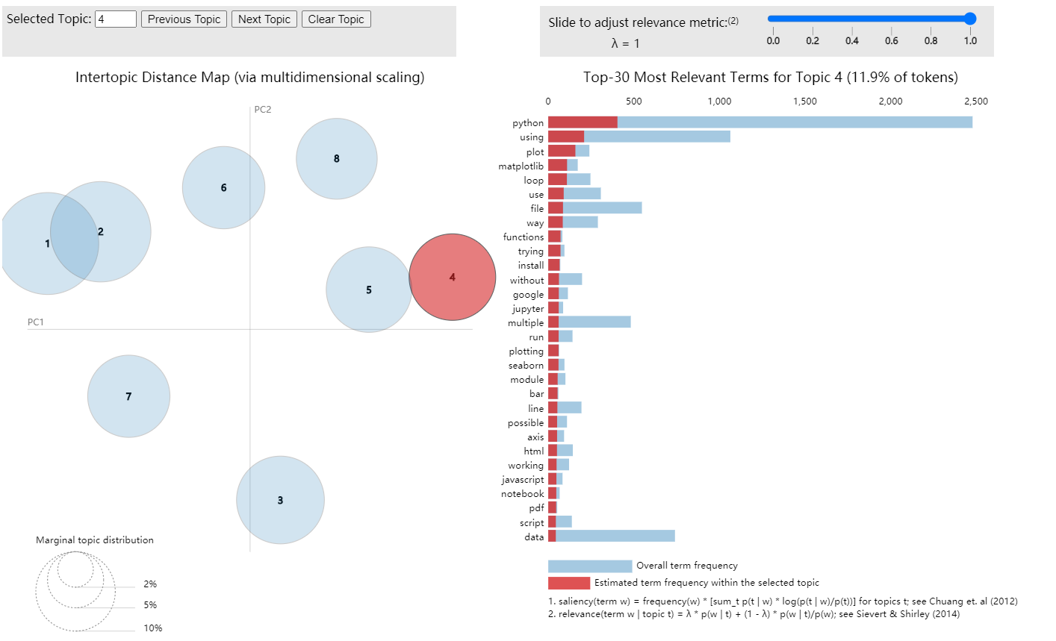
LDA
Model

Slide 16
Conclusion
Objective
Community Detection
Explore useful traininng and educatioal programs for users
Changing of community by time
Social frequent pattern
& centrality
Text analytics
Topic modeling for python
此部分内容作为文字排版占位显示 （建议使用主题字体）
Notes:
The use of social media and in particular community Question Answering (Q & A) websites by learners has increased significantly in recent years。The vast amounts of data posted on these sites provide an opportunity to investigate the topics under discussion and those receiving most attention.
The application of text mining and data analytics technologies in education has created a new interdisciplinary field of research between the education and information sciences, called Educational Data Mining (EDM)

Slide 17
Future Work
Improve our topic modeling to determine more details of subject difficulties for learners
Predict Closed Questions
Identify the most difficult and challenging topics commonly faced through sentiment analysis
Notes:
”Millions of programmers use StackOverflowto get high quality answers to their program-ming questions every day. There has evolved an effective culture of moderation to safe-guard it.More than six thousand new questions is askedon StackOverflow every weekday. Currently about 6% of all new questions end up ”closed”.Another future work is to build a classifier that predicts whether or not a question will be closed given the question as submitted, along with thereason that the question was closed.

Slide 18
Q&A
Thank You

